Slide 1
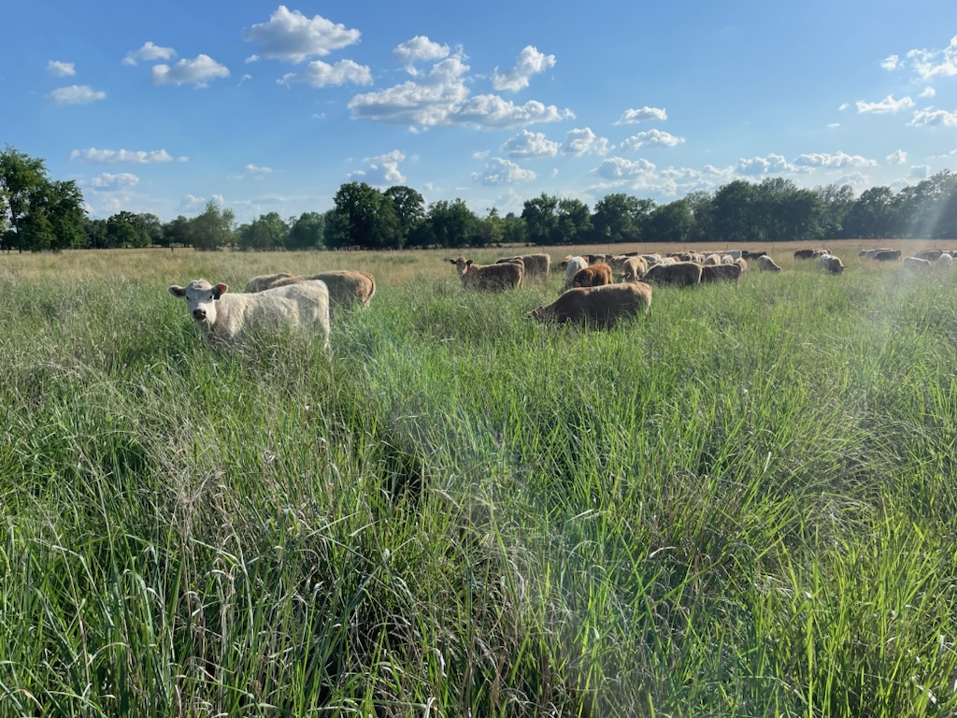
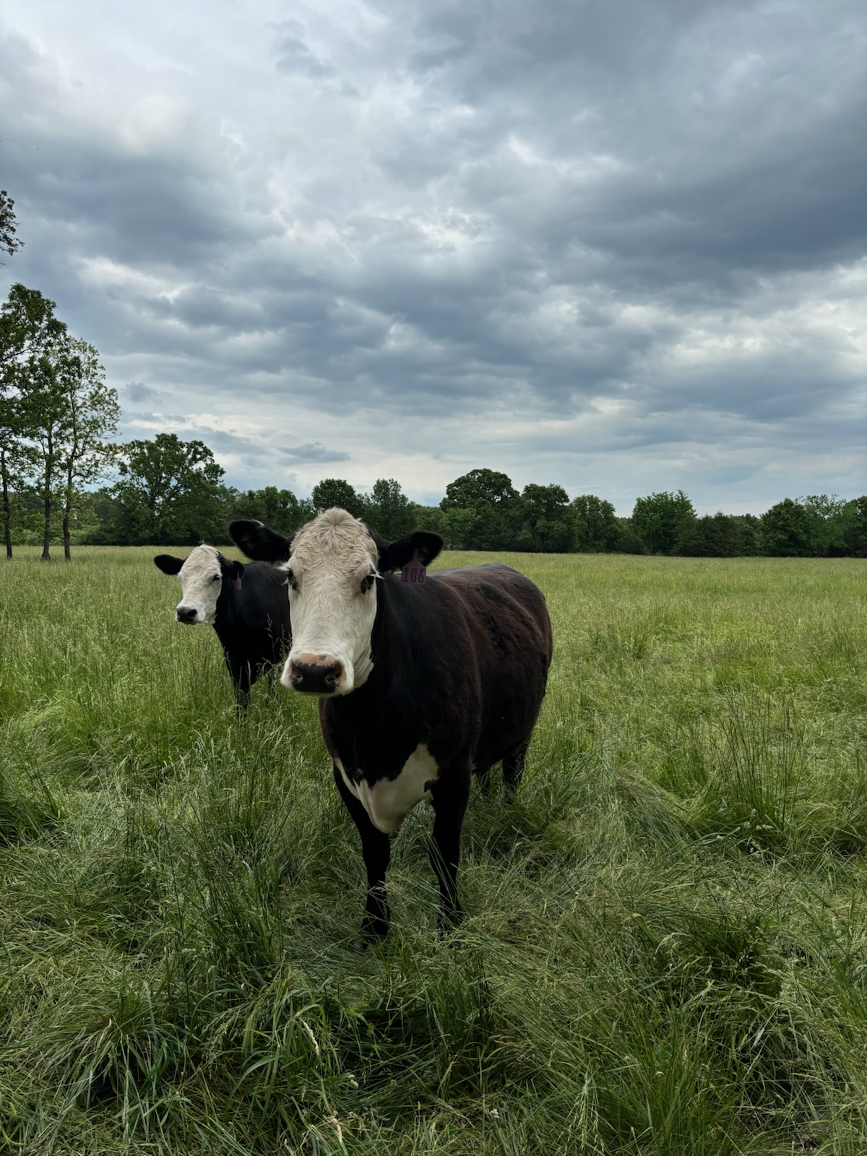

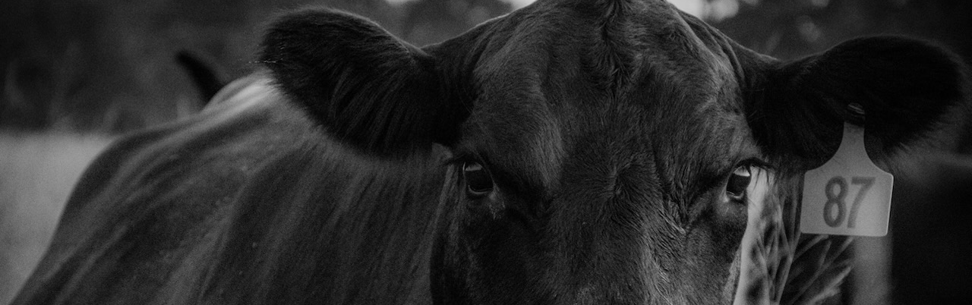
Presenter’s Name
Grazing management to optimize biological performance
Notes:
Local picture may be used. In reality we are managing the biological functions in our livestock to optimize performance. Whether it be a stocker we are trying to maximize weight gain on or a cow we are trying to keep in good body condition and productive. The same is true for our below ground biologic herd.

Slide 2
Objectives
Explain the similarities of the soil biology and the rumen of a grazing animal.
Describe how the management of forage effects the carbon flow into the soil.
Present a better understanding of the relationship of protein : energy and carbon : nitrogen.
Explain how balancing the nutritional needs of both the above ground and below ground livestock equates to both being more productive.

Slide 3
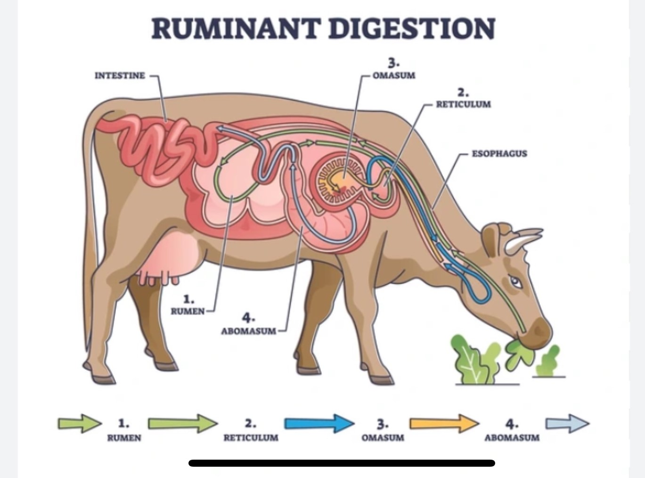
The Rumen
The biological space where forage is broken down into the needed nutrition of the animal.
Notes:
The rumen of a grazing animal is an anaerobic atmosphere that is alive with microbes. This is where carbohydrates and protein begin to be broken down by bugs that allows the animal to utilize them for nutrients and needed compounds for building body mass and bodily functions. The more efficient the rumen is the more efficient the animal will be in all classes of ruminate animals.

Slide 4
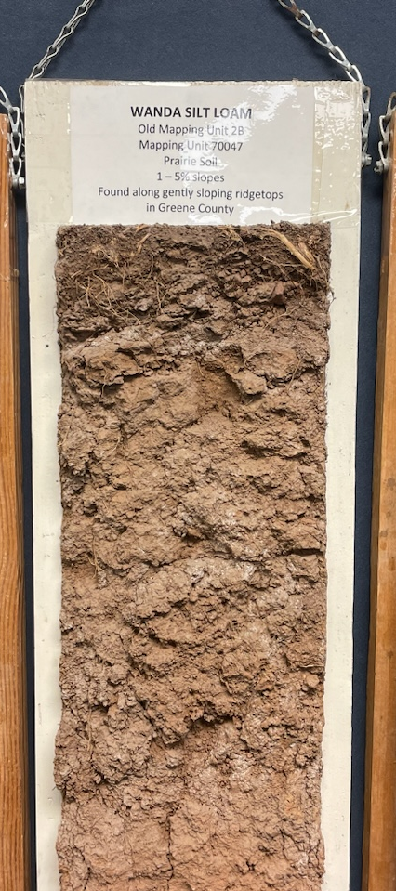
The Soil
The biological space where plants, roots and root exudes are broken down into the needed nutrition of the soil microbiome.
Notes:
Local picture may be used. The soil is generally an aerobic environment; however, soils need to support anaerobic biology at times of saturation and within individual aggregates. Each species has its own way of contributing to breaking down food sources and providing nutrients to plants for growth. Similar to the rumen the more efficient the microbial herd is the more efficient the production of forage is. Each being dependent on the other.

Slide 5
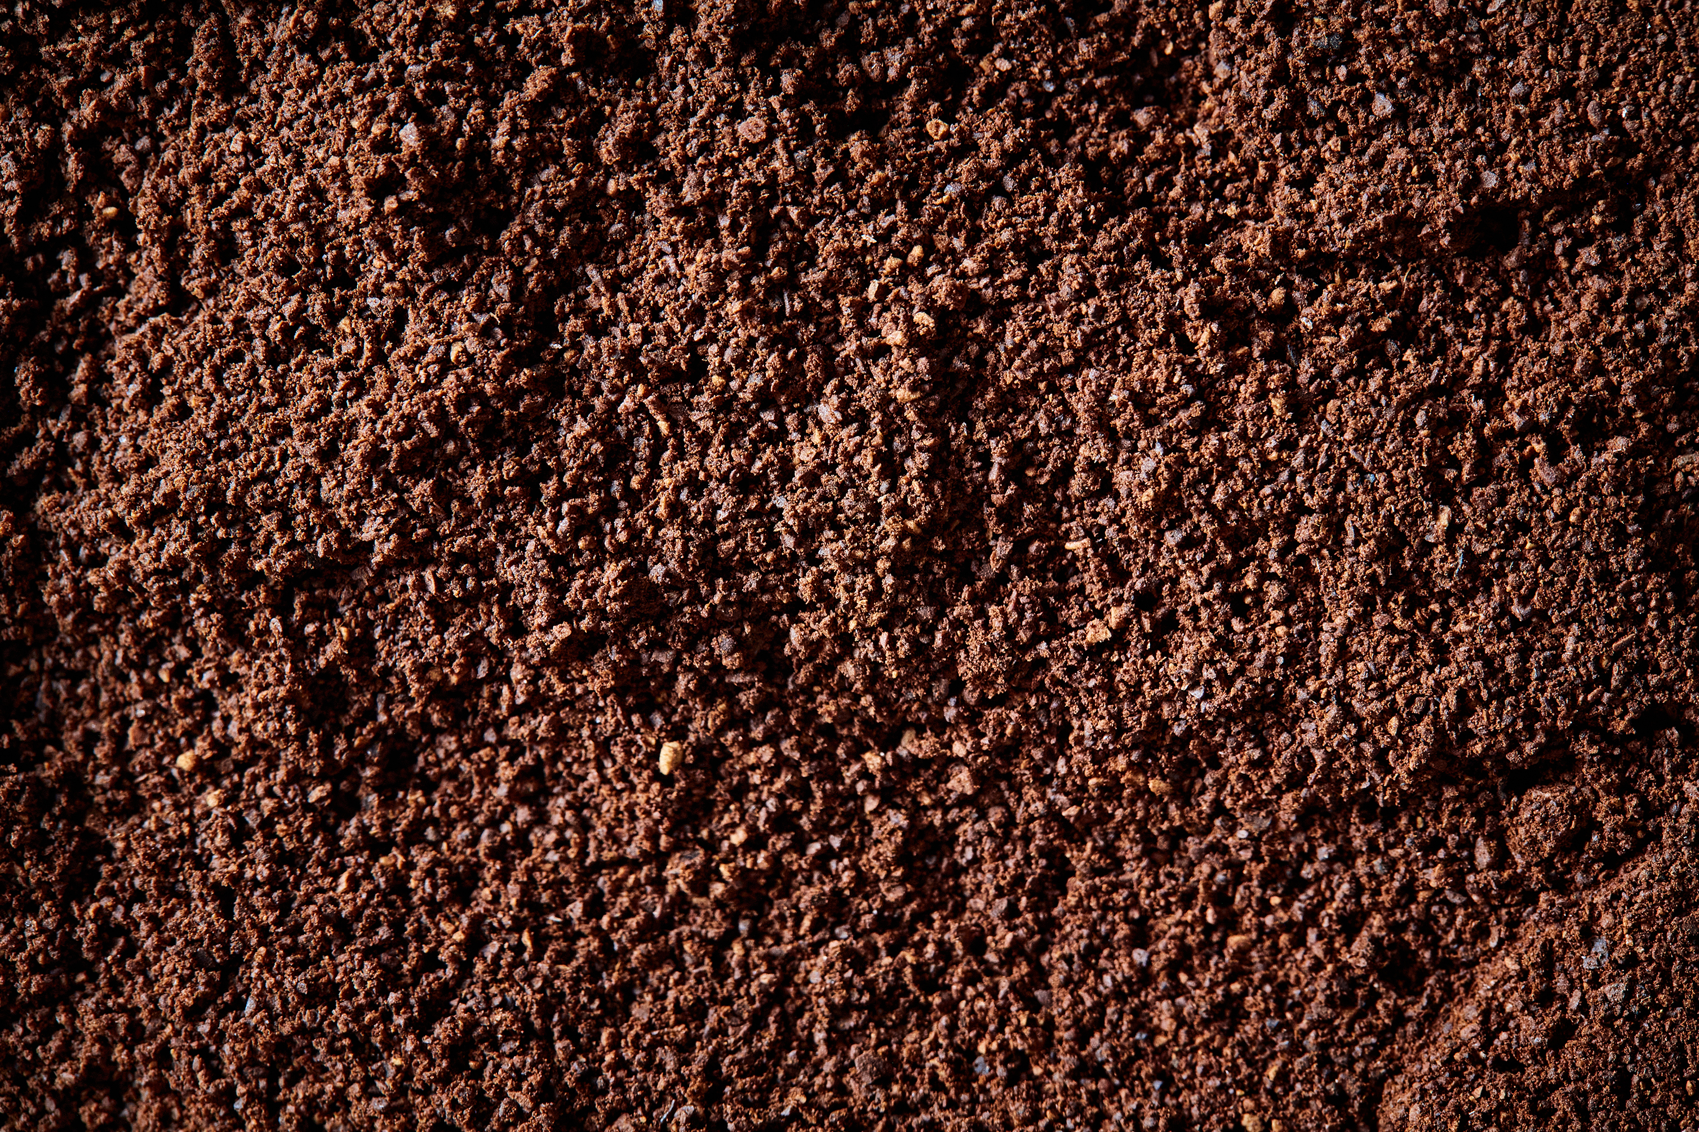
Protein : Energy
Carbon : Nitrogen
Protein : Energy = Above ground herd
Carbon : Nitrogen = Below ground herd
Notes:
There is a relationship between a livestock ration that is figured using protein and energy. This ratio changes with animal age and desired performance. The same goes for the carbon and nitrogen ration that we want to feed the soil. This too changes with desired outcome. The soil biology responds differently with the diet provided.

Slide 6
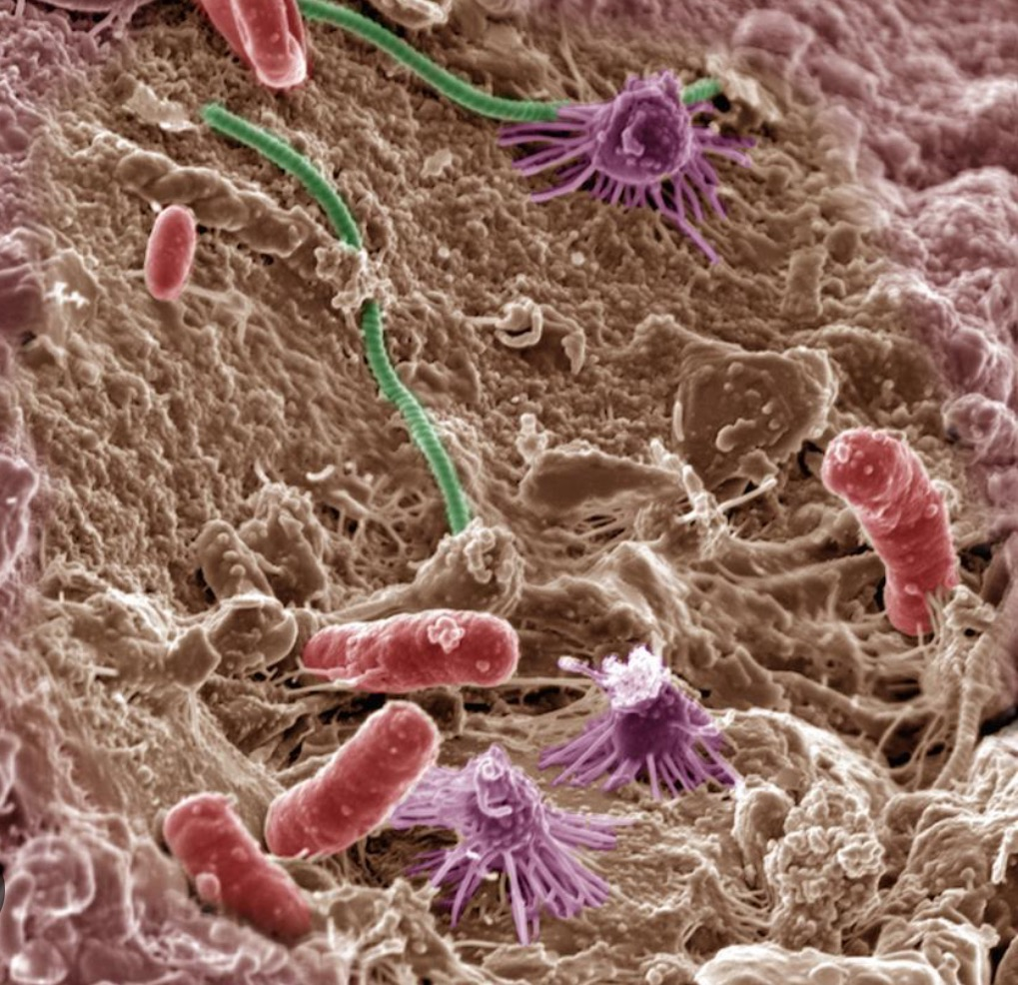
Carbon: Nitrogen
We think about carbon and nitrogen in terms of soil food.
Notes:
When looking at a cropping system, the current status of residue is always evaluated. Is there too much, is it decomposing at the proper rate and so one. We do a good job of considering the carbon to nitrogen ratios when designing cropping systems and prescribing a cover crop mix to compliment the cropping sequence. These same concepts need to be applied to pastures.

Slide 7
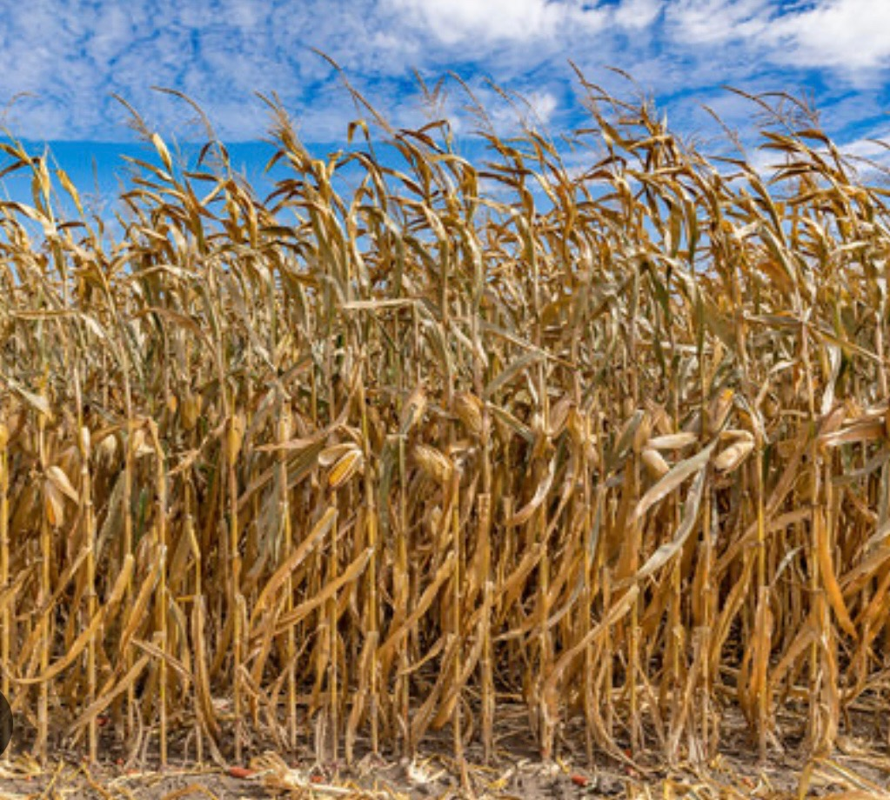
Carbon : Nitrogen
A continuous corn field would have a heavy carbon load and would be very sluggish with residue breakdown and nutrient cycling.
Notes:
Local picture can be used. This is an example of too much carbon and not enough nitrogen to break it down or digest it. This is assuming that corn is a continuous crop. This would be a good opportunity for a low carbon cover crop to help balance the ration for the biology.

Slide 8
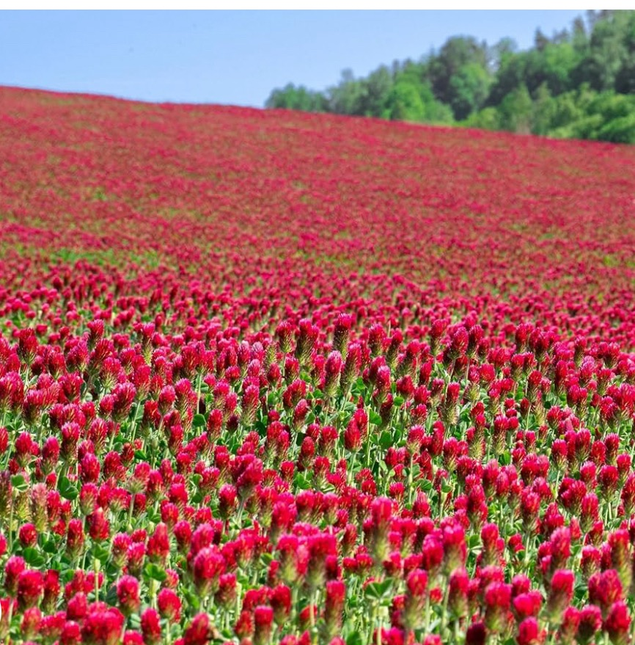
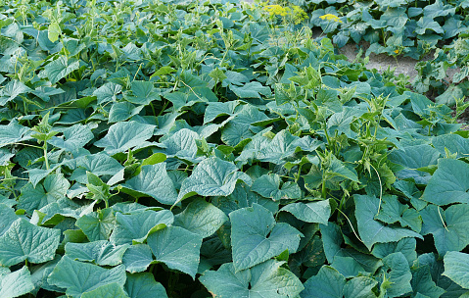
Carbon : Nitrogen (2)
A low carbon crop such as cucumbers or clover breaks down extremely fast and over excites nutrient cycling.
Notes:
Local picture can be used. This is an example of the opposite where too much high nitrogen residue is in the system and residue is broken down or digested way to fast and soil loses its armor. This would be an opportunity to include a higher carbon plant such as cereal rye.

Slide 9
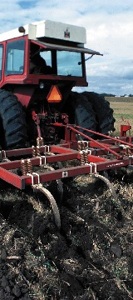
Carbon is Critical
Add more residue than microbes can consume, carbon is sequestered in the soil. Add less residue than microbes can consume, carbon is depleted.
Tillage or disturbance adds oxygen to soil and accelerates microbial activity/ consumption of carbon sources.
To build OM reduce tillage, grow high residue crops, and leave undisturbed root systems in the soil for microbes.
Notes:
Local picture can be used.

Slide 10
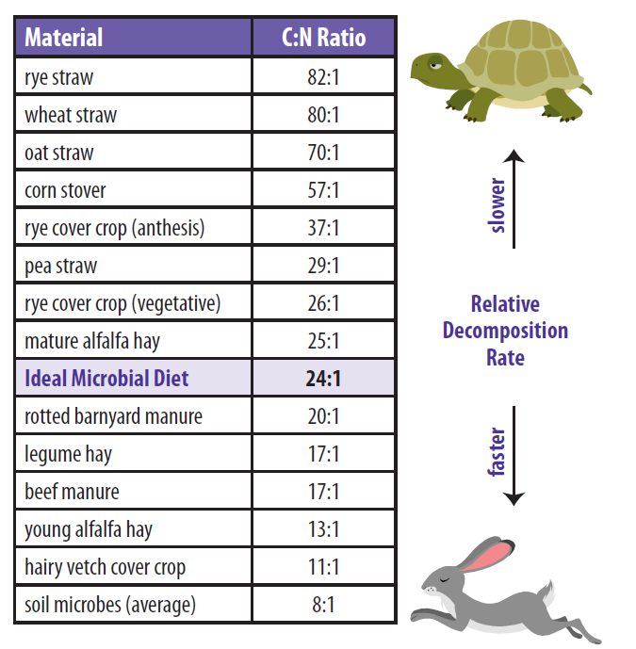
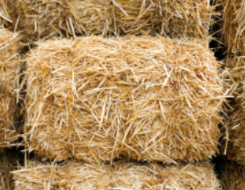
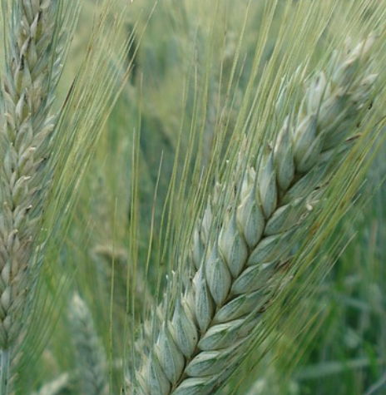
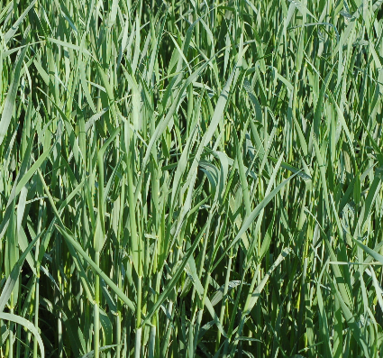
C:N Ratio (Nutrients Availability & Decomposition Rate)
Notes:
Understanding plant species growth stage and relationship to Carbon:Nitrogen is key to overall strategies SEE HANDOUT C:N RATIO NRCS
Review chart and discuss various situations. Notice that Rye has varying C:N ration depending on when it is terminated.
Low C:N ration plants breakdown quickly, discuss the advantages and disadvantages of this,

Slide 11
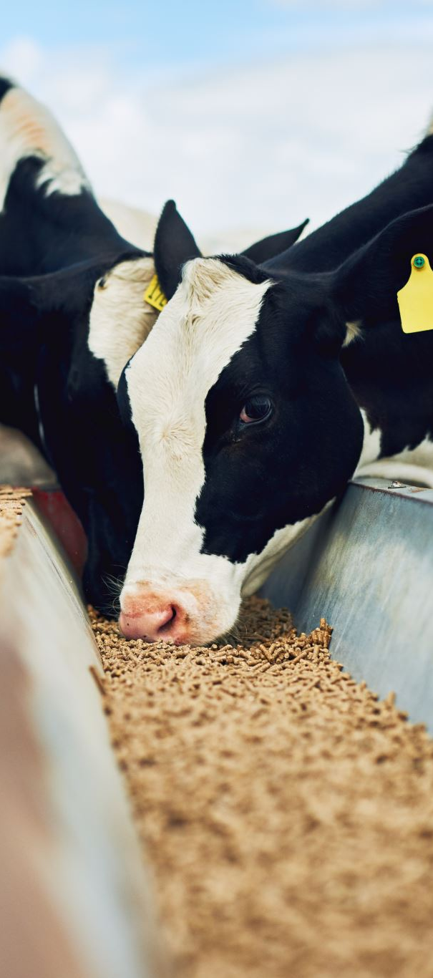
Protein: Energy
These are familiar terms we think of when considering animal nutrition in feed rations
Notes:
These are the terms we are familiar with when we think about feed rations for grazing animals. Those producers who are looking for peak animal performance such as back grounding or feed lot operations are very in tune with balancing their rations. It is often tested and adjusted for the size and class of animal. We need to apply this level of thought to feeding our soil.

Slide 12
Nutritional Needs
Proteins
Amino acids
Nitrogen
The building blocks of muscle and bone
Notes:
Missouri Grazing Manual.. Fred Martz, Valerie Tate, Jim Gerrish
Just putting context to proteins and what they are and how the animal uses them to grow and function.

Slide 13
Nutritional Needs (2)
Carbohydrates
Energy
Carbon
C + H + O
Put 6 together = Glucose
C6 + H12 +06
Notes:
Missouri Grazing Manual.. Fred Martz, Valerie Tate, Jim Gerrish
Missouri Grazing Manual.. Fred Martz, Valerie Tate, Jim Gerrish
Explain how Carbohydrates a familiar livestock consideration is related to carbon.

Slide 14
Generally, as plants mature they lignify and carbon content goes up as protein goes down
Protein : Down
Carbon : Up
Carbon
Protein
Notes:
As plants mature or get more stemmy they are increasing in carbon content. The feed value generally decreased due to digestibality but that is not the case for the soil. The biological difference in the soil makes it quit capable of processing the higher carbon stocks.

Slide 15
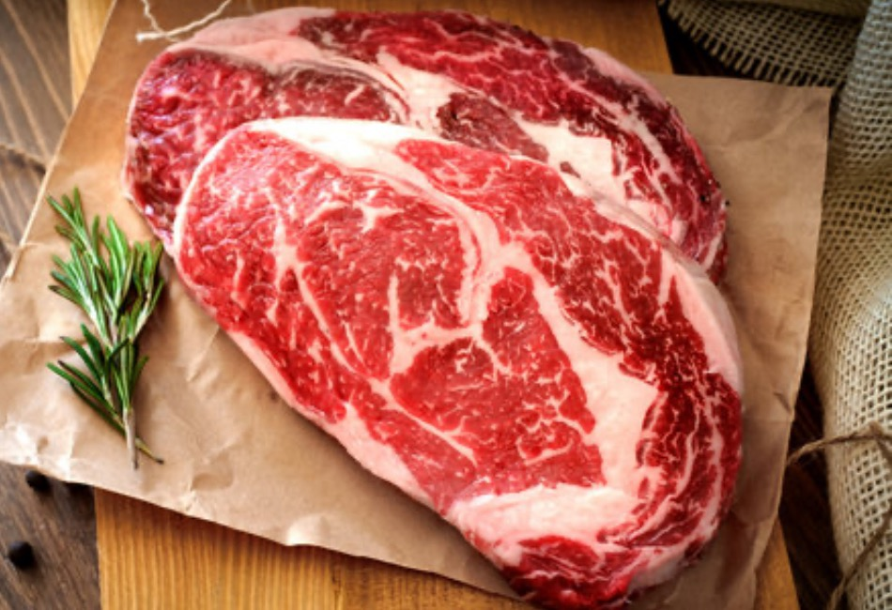
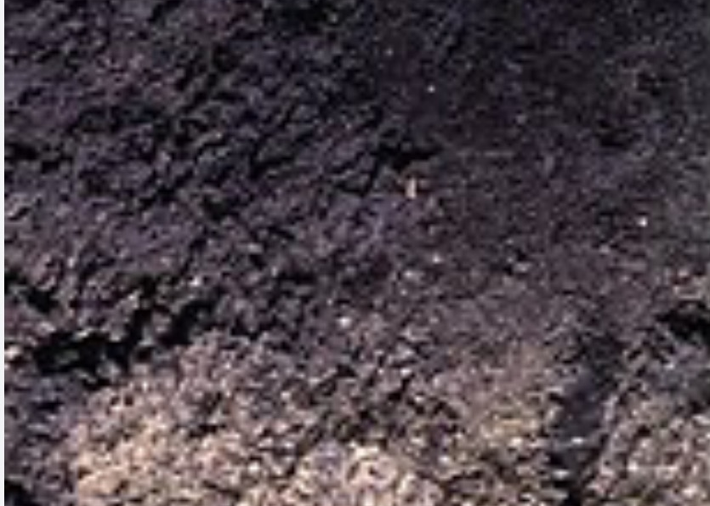
Nutritional Needs (3)
Livestock/Soil
Animals store energy in the form of fat.
The soil stores energy in the form of soil carbon.
Notes:
Explain the similarities of how each the animal and soil store energy. When these are considered, it is easier to understand how to build soil carbon.

Slide 16
Nutritional Needs (4)
Over feeding protein inputs will reduce fat stores.
To build fat, feed higher amounts of energy than needed and enough protein to process into body fat.
Notes:
Missouri Grazing Manual.. Fred Martz, Valerie Tate, Jim Gerrish
Just putting context to proteins and what they are and how the animal uses them to grow and function.

Slide 17
Nutritional Needs (5)
Soil Herd
When we over feed nitrogen (protein), we burn fat (calories
To build SOM (fat) feed higher amounts of carbon than needed and enough protein to process it

Slide 18
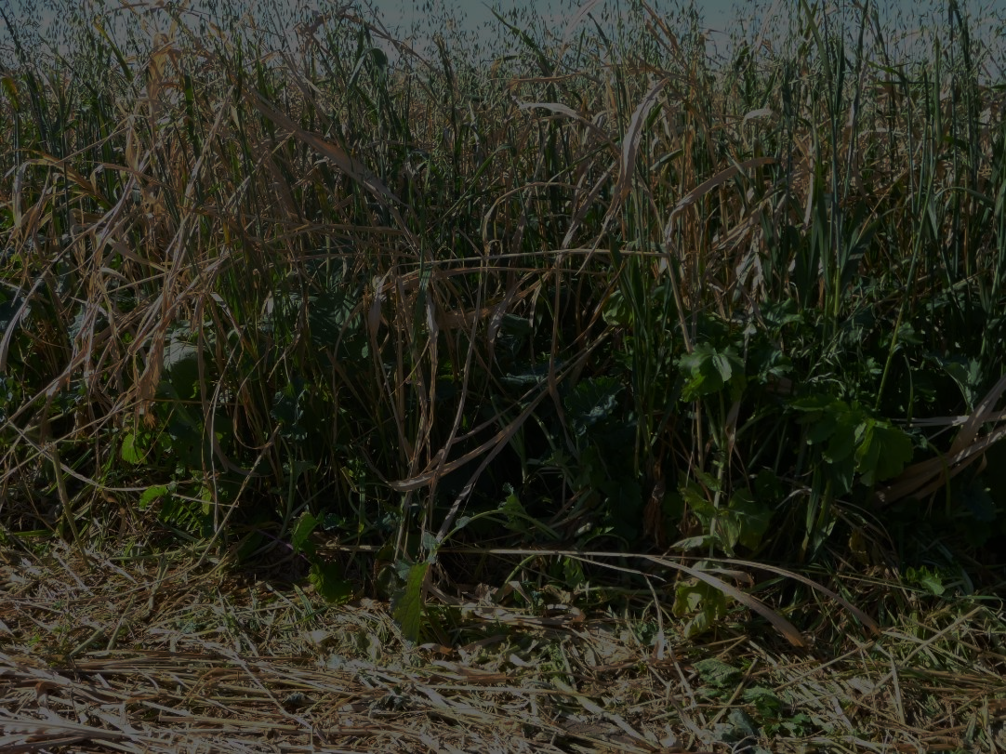
Forage Quality
Feed the
animal
As livestock graze closer to the soil, the forage quality will decline
Higher Forage Quality
CP: 14% TDN: 63.5% RFV: 149.1
50% by Weight
Lower Forage Quality
CP: 7.2% TDN: 56.3% RFV: 97.9
Feed to the soil
Marlon Winger, USDA-NRCS
Notes:
Whether grazing cover crops or perennial forages, the highest forage quality (energy and protein) is in the leaves that are the most photosynthetically active or nearest the sun. This is part of the reason why we don’t want livestock in a paddock too long, especially if high rates of gain are desired or if there is to be a second graze.
Forage quality data from the Menoken Farm in Burleigh County, ND (Jay Fuhrer) showed that on a nine-way species mix with cool and warm-season grasses, brassicas, and legumes, the top half of the mixture (by weight) had nearly twice as much crude protein, nearly 13% higher energy measured as Total Digestible Nutrients (TDN), and 52% greater Relative Feed Value (RFV).
How would these values differ if only the top one-third or one-fourth was grazed? They would be higher yet, enough to sustain very high rates of gain for performance livestock.

Slide 19
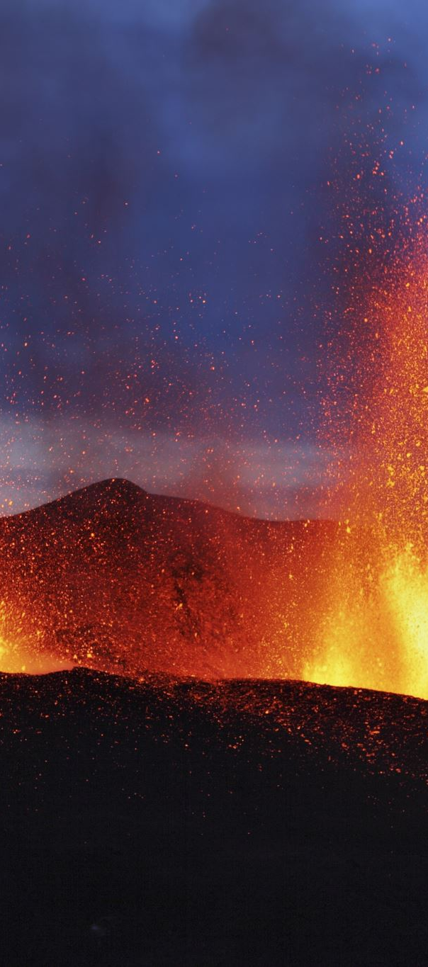
Nutritional Needs (6)
Fortunately, both the soil and animal can ebb and flow on a varied diet with out radical reactions.
Notes:
These are the terms we are familiar with when we think about feed rations for grazing animals. Those producers who are looking for peak animal performance such as back grounding or feed lot operations are very in tune with balancing their rations. It is often tested and adjusted for the size and class of animal. We need to apply this level of thought to feeding our soil.

Slide 20

Nutritional Needs (7)
As the seasons of growth change during the grazing year, so does the nutritional needs of the grazing animal.
Notes:
These are the terms we are familiar with when we think about feed rations for grazing animals. Those producers who are looking for peak animal performance such as back grounding or feed lot operations are very in tune with balancing their rations. It is often tested and adjusted for the size and class of animal. We need to apply this level of thought to feeding our soil.

Slide 21
Nutritional Needs (8)
Use the grazing animal to feed the soil for a desired outcome without reducing animal performance.
Drexel Atkisson, USDA-NRCS
Notes:
Whether grazing cover crops or perennial forages, the highest forage quality (energy and protein) is in the leaves that are the most photosynthetically active or nearest the sun. This is part of the reason why we don’t want livestock in a paddock too long, especially if high rates of gain are desired or if there is to be a second graze.
Forage quality data from the Menoken Farm in Burleigh County, ND (Jay Fuhrer) showed that on a nine-way species mix with cool and warm-season grasses, brassicas, and legumes, the top half of the mixture (by weight) had nearly twice as much crude protein, nearly 13% higher energy measured as Total Digestible Nutrients (TDN), and 52% greater Relative Feed Value (RFV).
How would these values differ if only the top one-third or one-fourth was grazed? They would be higher yet, enough to sustain very high rates of gain for performance livestock.

Slide 22
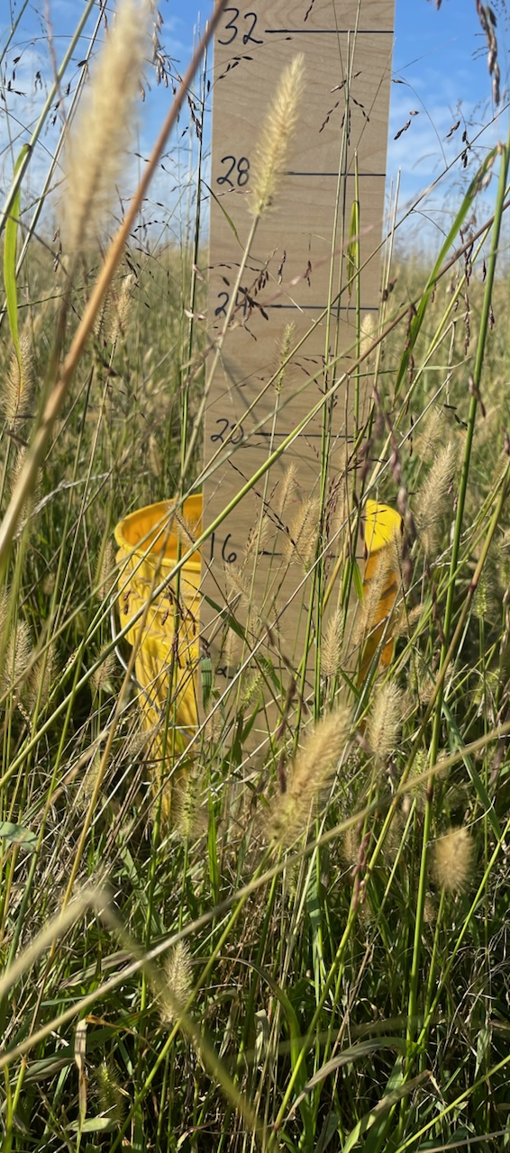
Example:
Cows after weaning in the 3rd stage of gestation can make use of a mature forage, this builds carbon in the soil and fat on the animal.
Nutritional Needs (9)
Drexel Atkisson, USDA-NRCS
Notes:
Picture may be replaced with a local representation. Cows that are not nursing calves in the third stage of pregnancy can make use of much more mature forage. This allows for some paddocks to be rested longer. There needs to be a basic understanding of livestock type and class, the changing dietary needs during pregnancy, and desired daily gain on growing animals.

Slide 23
Effect on Carbon Cycle with Livestock
Plants
CO₂
Respiration
Photochemical
oxidation
Rumen
microorganisms
Livestock
CH₄
Soil organic
matter
Manure
Notes:
Now look at this carbon cycle. Without animal inputs, the cycle is less complex with photosynthesis to plants to respiration and back to CO₂. With herbivores introduced, soil microbes take the carbon in manure which has been altered by processes (including gut microorganisms) in livestock and further decompose to soil organic matter and plant available nutrients. Livestock converts forages to forms that soil organisms can more efficiently convert (in the right conditions) into stable organic matter. So the whole carbon cycle is enhanced.

Slide 24
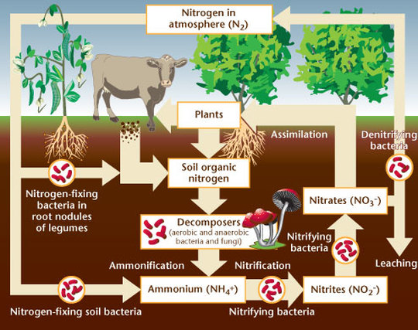
Effect of Grazing on Nitrogen Cycle
Notes:
Explain the similarities of how each the animal and soil store energy. When these are considered, it is easier to understand how to build soil carbon.

Slide 25
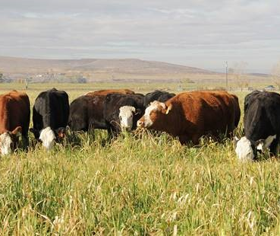
Carbon to Nitrogen Ratios
Carbon equates to energy.
Nitrogen equates to protein.
Biological acceleration, improving soil health at faster rate.
  Add biology
  Incorporation of organic organic matter
Additional source of income
Increased nutrient cycling (C/N ratios impacts)
Marlon Winger, USDA-NRCS
Notes:
[Picture can be replaced with a more local representation.]
Photo: Cattle grazing cover crop mix on irrigated cropland in southern Idaho.

Slide 26
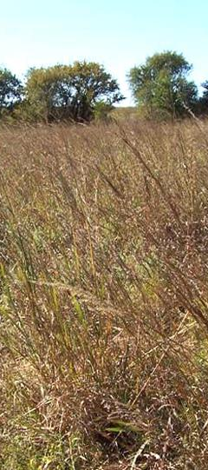
Impacts on Soil Health
Research on grasslands in TX – compared to heavy or light continuous grazing, multi-paddock grazing offered:
  Greater soil cover
  Lower soil penetration resistance
  Lower sediment loss
  Higher OM and CEC
  Increased fungal population
Photo by: Texas A&M University
Notes:
[Picture can be replaced with a more local representation.]
Teague, W.R., Dowhower, S.L., Baker, S.A., Haile, N., DeLaune, P.B., Conover, D.M., 2011. Grazing management impacts on vegetation, soil biota and soil chemical, physical and hydrological properties in tall grass prairie. Agriculture, Ecosystems and Environment. 141, 310-322.

Slide 27
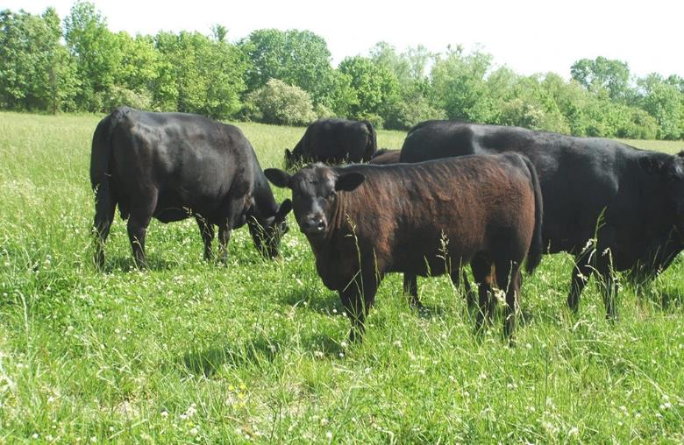
Impacts on Soil Health (2)
On-farm trial in MS comparing high stock density rotational grazing to continuous grazing:
  Several times higher total soil carbon in topsoil and subsoil
  Significantly greater soil organic matter in topsoil and subsoil
Photo by Joyce Farms
Notes:
[Picture can be replaced with a more local representation.]
Presentation by Allen Williams at Grassfed Exchange 2016 conference

Slide 28
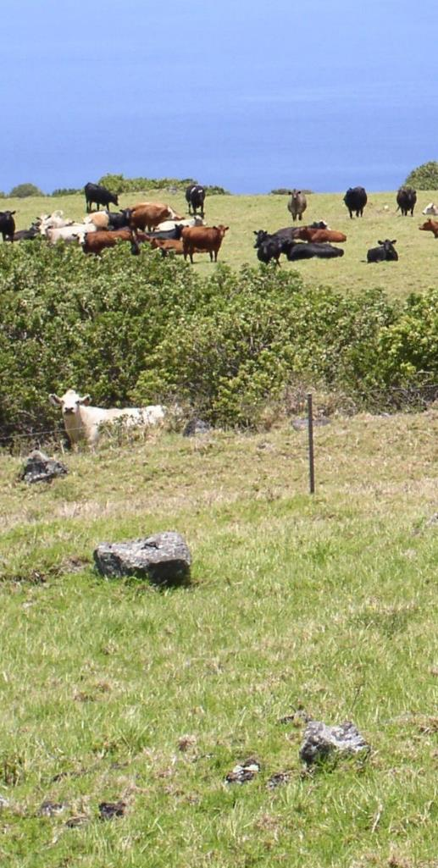
What are some Advantages from Grazing Grasslands for soil health?
High quantity & quality forage for livestock from perennials
Grazing providing for adequate leaf area:
  Protects soil from raindrop impact
  Evaporation decreases
  Infiltration increases
  Improve plant vigor
Maintains/improves plant diversity
Carolyn Wong, USDA-NRCS
Notes:
[Picture can be replaced with a more local representation.]

Slide 29
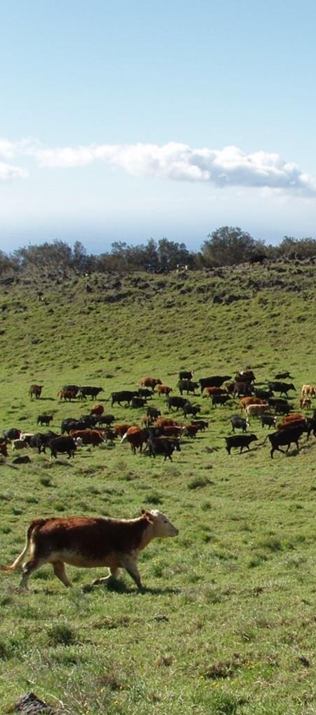
What are some Advantages from Grazing Grasslands for soil health? (2)
Reduces the need for mechanical harvest
Biological acceleration, improving soil health at faster rate
  Add biology
  Incorporation of organic matter
Increases nutrient cycling (C:N ratio)
Improve animal health
Carolyn Wong, USDA-NRCS
Notes:
[Picture can be replaced with a more local representation.]

Slide 30
Summary
The soil and rumen are not very different in their function.
The nutrition in the forage is dynamic, as is the nutritional needs of the animal, therefore our management needs to be just as dynamic.
Building soil health is about controlling the carbon flow.

Slide 31
Thank you!
For more information on Managing Soil Health,
visit us here:
https://www.nrcs.usda.gov/conservation-basics/natural-resource-concerns/soils/soil-health
USDA is an equal opportunity provider, employer, and lender.

